Slide 1

Generative AI vs Discriminative AI : Concepts , differences and tools
By
Dr. Aniruddha Nag , Associate Professor,Techno india
Ex-Manager at TATA Air India, EX- Secretary ,IETE, Kol , Ex-Chairman CSI, Kol
Ex-Director Universal Hardsoft

Slide 2
Difference between ML and Generative AI
Machine learning and generative AI both learn from data, but their purposes and strategies differ.
Machine learning is focused on analyzing data to find patterns and make accurate predictions. Generative AI, on the other hand, is focused on creating new data that resembles training data.

Slide 3
Machine Learning
Machine learning (ML) is a class of artificial intelligence methods characterized by their not providing direct solutions to problems but rather training systems to apply solutions.
There are many methods of machine learning, but they can roughly be divided into two groups:
learning with a teacher
learning without a teacher.

Slide 4
Machine Learning
In the case of learning with a teacher, a person supplies the machine with initial data in the form of situation–solution pairs. The machine learning system then analyzes these pairs and learns to classify situations based on known solutions. For example, a system can learn when to mark incoming messages as spam.
In the case of learning without a teacher, the machine receives unsorted information — situations — without solutions and learns to classify those situations based on similar or different signs without human guidance.

Slide 5
Introduction
Before going into details take one example,A consumer is interested in e-book readers. She searches e-readers at Google, and reads about the products at a few websites. While watching Youtube several days later, she sees an e-reader ad. Interested, she visits the firm's website, browsing through the product description and having a few questions answered via live-chat. She then reads consumer reviews at a third-party website. Over the next few days, she is frequently exposed to ads about that e-reader while web surfing. After receiving a coupon in email, she follows the link and places an order. Happy about the product, she describes her usage experience on Facebook, and posts a few pictures on Instagram. Her friends comment on the posts with interest.

Slide 6
Chatbots and Virtual Assistants
Essence: Automating customer interactions and service requests.
What it predicts: The intent and context behind a user's question or statement.
How this data is used: To provide relevant responses or actions.
Result: Quick, consistent, and scalable customer support or engagement.
Common algorithms for this purpose: Natural Language Processing (NLP) and Seq2Seq models.
Examples: Google Assistant doesn't just respond to queries; it uses machine learning to understand context, user preferences, and even nuances in voice tone. This continuous learning allows it to provide more accurate and personalized responses over time.

Slide 7
Generative AI
Generative AI focuses on producing unique and fresh content. It consists of a generator and a discriminator that work together to create realistic and distinctive outputs. The discriminator evaluates the generated samples and distinguishes them from accurate data, while the generator produces new pieces like images, sounds, or texts. This process is repeated until the generator can produce outputs indistinguishable from real data. Generative AI has various applications, including text creation, virtual characters, images, and videos. It can revolutionize entertainment, design, and marketing by offering original and innovative ideas.

Slide 8
Generative AI
On November 2022, a prototype generative artificial intelligence (AI) chatbot ChatGPT was made publicly available by OpenAI, a Microsoft-backed company. Based on advanced AI language models, ChatGPT quickly gained a lot of traction with its ability to understand and respond in natural language. To date, it is the fastest-growing innovation, having reached 100 million active adoptions in two months. Now, there is a lot of hype surrounding applications of large language model (LLM) which includes ChatGPT (OpenAI), Bard (Google), and Claude (Anthropic). The wave of generative AI is expected to drive a $7 trillion increase in global gross domestic product and boost productivity growth by 1.5% over ten years.

Slide 9
Generative AI
Generator:
The generator is a neural network responsible for generating new data instances that resemble a given dataset. It takes random noise as input and produces synthetic data samples.
In a GAN, the generator's goal is to create data that is indistinguishable from real data. The generator starts with random noise and, through training, learns to generate increasingly realistic samples.
Discriminator:
The discriminator is another neural network that evaluates whether a given input is real (from the actual dataset) or fake (generated by the generator).
The discriminator is trained to distinguish between real and generated data. It assigns probabilities to input data, indicating the likelihood that the data is real.
The goal of the discriminator is to become skilled at distinguishing between real and fake data, while the generator aims to produce data that is convincing enough to fool the discriminator.

Slide 10
Key Difference between Two Models
The fundamental difference is that discriminative models learn to discriminate between existing classes, while generative models learn to generate new data by understanding the underlying data distribution. A generative AI model could be trained on a dataset of images of cats and then used to generate new images of cats. A discriminative AI model could be trained on a dataset of images of cats and dogs and then used to classify new images as either cats or dogs.

Slide 11
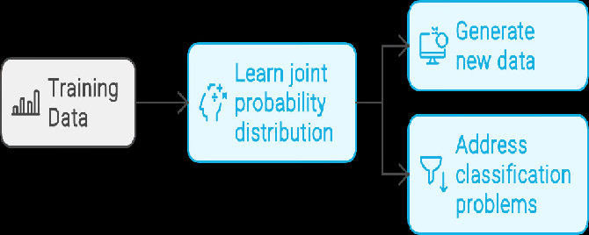
Generative Model

Slide 12
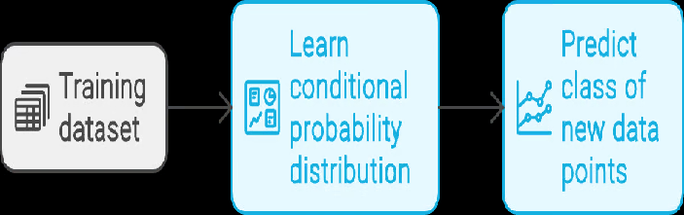
Discriminative Model

Slide 13
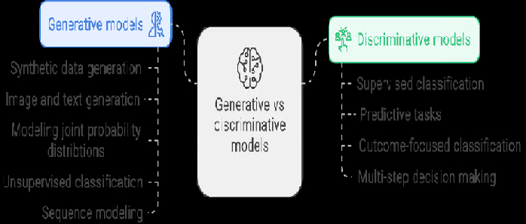
Generative vs Discriminative Models

Slide 14
Parametres | GENERATIVE ALGORITHM | DISCRIMINATIVE ALGORITHM
Objective | Models the joint probability distribution of the input characteristics and labels in a generative manner. | Modeling the conditional probability distribution of labels given input attributes is the main focus of discriminative modeling.
Methodology | Creates new samples by learning the distribution of the underlying data. | Acquires the threshold of judgment that distinguishes various classes or categories.
Application | Text generation and image synthesis are examples of generative tasks. | Used in activities like sentiment analysis and image categorization.
Strength | Effective with inadequate or missing data | Excellent at distinguishing between classes or categories is discrimination.
Weakness | May have trouble distinguishing different classes in large datasets. | Less useful when dealing with incomplete or missing data

Slide 15
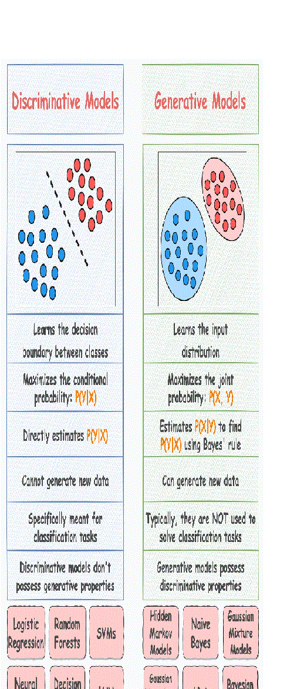

Slide 16
Generative Models
Goal:
To learn the underlying probability distribution of the data to understand how data is generated.
Probability:
They model the joint probability P(X,Y) or just P(X) for unlabeled data, which represents how likely a given example is.
Task Examples:
Data Generation: Creating new images, music, or text that resembles the original training data.
Handling Missing Data: Can work more effectively with incomplete datasets due to their understanding of the full data distribution.
Pros:
Can generate new, realistic data samples.
More flexible and better at handling missing data.
Cons:
More complex and computationally expensive to train, requiring more data.
May not achieve as high accuracy as discriminative models for classification tasks.

Slide 17
Discriminative Models
Goal:
To learn the direct relationship between inputs and their corresponding labels, focusing on the decision boundary that separates classes.
Probability:
They model the conditional probability P(Y|X), which is the probability of a label (Y) given an input (X).
Task Examples:
Classification: Distinguishing between images of cats and dogs.
Regression: Predicting a continuous value.
Pros:
Often achieve high accuracy for classification tasks.
Simpler and faster to train as they focus only on distinguishing classes.
Cons:
Cannot generate new data samples because they don't learn the data distribution itself.
Can struggle with smaller datasets.

Slide 18
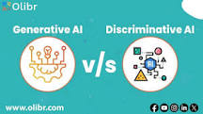
Which is more accurate, generative AI or discriminative AI?
But when it comes to training the AI model, discriminative AI is faster and easier to train than generative AI. Also, it provides more accurate results than generative models. Having said that, it is not best suited for tasks where the underlying data distribution is complex or uncertain.

Slide 19
Popular AI tools
ChatGPT and Gemini are strong all-around conversational AIs, with ChatGPT noted for its broad popularity and robust capabilities, while Gemini excels at integrating with Google services and handling large context windows. Claude is a leader in complex tasks, particularly coding, writing, and detailed analysis due to its extensive context. Midjourney and DALL-E are image generation tools, with Midjourney favored for highly artistic and imaginative outputs and DALL-E (now often integrated with ChatGPT) known for generating realistic and precise images.

Slide 20
ChatGPT (Open AI)
Primary Use: Best for general assistance, conversation, and a wide range of tasks, offering the most "bang for your buck" in terms of overall utility.
Strengths: Excels at reasoning, multimodal capabilities (handling different input formats), and has strong conversational memory.
Considerations: A paid subscription is often needed to unlock its most advanced features.

Slide 21
DALL-E (OpenAI)
Primary Use:
An image generation tool excellent for creating realistic and detailed images from text prompts, often integrated with other tools like ChatGPT.
Strengths:
Known for its ability to interpret simple natural language prompts and automatically refine them for image generation, making it user-friendly.

Slide 22
Gemini (Google)
Primary Use: Strong for budget-conscious users and building AI products, especially when leveraging Google's ecosystem.
Strengths: Offers a large context window for analyzing extensive documents and integrates smoothly with Google apps and data.
Considerations: While free to use, the advanced tier offers significant advantages.

Slide 23
Claude (Anthropic)
Primary Use:
Ideal for tasks requiring deep analysis of lengthy documents, complex writing, and coding.
Strengths:
Features a large context window for analyzing extensive inputs, excels at coding and math, and is well-suited for detailed research summaries and content organization.
Considerations:
Can be the most expensive option, and its strong safety tuning may sometimes limit responses.

Slide 24
Midjourney
Primary Use:
A powerful tool for generating artistic, imaginative, and abstract images with a strong creative focus.
Strengths:
Excellent for creating highly artistic visuals, though it requires more technical, tailored input and has a steeper learning curve.
Considerations:
Its customization

Slide 25
To set your Choice
To choose the right one, consider your primary goal:
For general content creation and conversation: ChatGPT is a solid choice.
For technical tasks and up-to-date information: Gemini is the better option.
For writing sensitive content or complex reasoning: Claude is the strongest contender.
For generating artistic, imaginative, and abstract images: Midjourney is the choice

Slide 26
Midjourney (Paid)
https://cdn.midjourney.com/video/d3e5d4c5-4d85-4c53-adb8-5300909c2f55/0.mp4

Slide 27
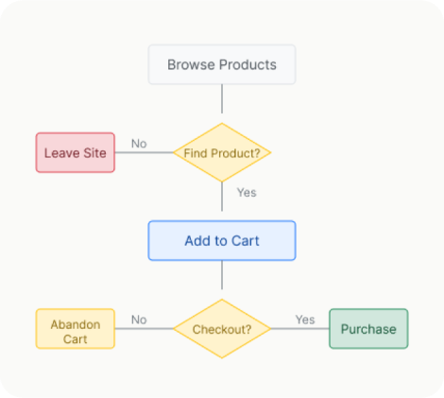
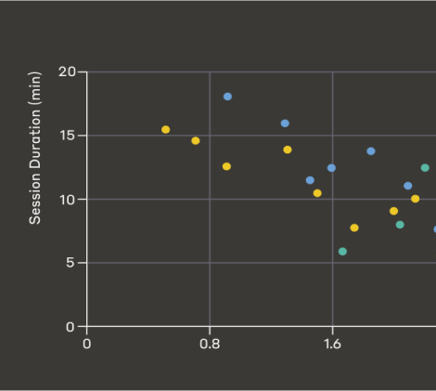
Claude (Paid /Free)
Flowcharts & diagrams
Data Visualization
Interactive quizzes
Coding projects
Learning tools
https://claude.ai/artifacts

Slide 28
Gemini (Paid /Free)
Gemini two versions 2.5 flash and 2.5Pro
Writing
Research
Learning
Quiz

Slide 29
Dall-e (Paid/Credits version)
Dall-e is not a search engine but creating image /photo from Text
Cartoon
3D image
Painting
Illustrations

Slide 30
ChatGpt(Free)
ChatGPT, created by OpenAI
Understands and generates human-like text by analyzing vast amounts of information to answer questions,
Brainstorm ideas
Assist writing, coding, image generation, and translation

Slide 31
Large Language Models (LLMs)
Large Language Models (LLMs) are advanced artificial intelligence systems that are trained on massive datasets of text to understand, generate, and manipulate human-like language. They use a transformer architecture and deep neural networks to learn patterns, relationships, and context within language, allowing them to perform tasks such as text generation, summarization, translation, question answering, and code generation. LLMs are foundational to modern AI and power applications like chatbots and virtual assistants by predicting the most probable next word in a sequence to generate coherent and relevant responses.

Slide 32
How LLMs Work
Massive Training Data:
LLMs are trained on enormous amounts of text data from various sources like books, websites, and transcripts.
Transformer Architecture:
They use a deep learning architecture called a transformer, which excels at processing sequential data like text.
Pattern Recognition:
Through this architecture, LLMs identify patterns, sequences, and relationships between words and phrases to understand grammar, syntax, and semantics.

Slide 33
How LLMs Work
Next-Word Prediction:
The core function of an LLM is to predict the next most probable word in a given sequence of text, a skill honed through self-supervised learning.
Fine-tuning:
After initial training, LLMs can be further fine-tuned on smaller datasets for specific tasks, enhancing their performance in particular domains or applications.

Slide 34
Key Capabilities and Uses
Text Generation: Creating human-like text for various purposes, from creative writing to content creation.
Summarization: Condensing large amounts of text into shorter, informative summaries.
Question Answering: Providing comprehensive answers to questions based on their vast training data.
Translation: Translating text from one language to another.
Code Generation: Assisting developers by generating code snippets and helping with programming tasks.
Chatbots and Virtual Assistants: Powering conversational AI systems that can interact naturally with users.

Slide 35
Different Models
LLMs represent a significant breakthrough in NLP and artificial intelligence, and are easily accessible to the public through interfaces like Open AI’s Chat GPT-3 and GPT-4, which have garnered the support of Microsoft. Other examples include Meta’s Llama models and Google’s bidirectional encoder representations from transformers (BERT/RoBERTa) and PaLM models. IBM has also recently launched its Granite model series.

Slide 36
Prompt engineering
Prompt engineering is the process of writing effective instructions for a model, such that it consistently generates content that meets your requirements.
Because the content generated from a model is non-deterministic, prompting to get your desired output is a mix of art and science. However, you can apply techniques and best practices to get good results consistently.
Some prompt engineering techniques work with every model, like using message roles. But different model types (like reasoning versus GPT models) might need to be prompted differently to produce the best results. Even different snapshots of models within the same family could produce different results.

Slide 37
How prompt engineering works
Input: A user provides a natural language prompt to the AI model.
Processing: The AI processes the prompt, using its internal mechanisms to understand the instructions and context.
Output: The AI generates a response based on its understanding of the prompt.

Slide 38
Applications of prompt engineering
Chatbots: To ensure they provide accurate and contextually relevant responses.
Software development: To generate code snippets or solve programming challenges.
Healthcare: To process medical data and provide insights.
Content creation: To produce various types of written content.

Slide 39
Thank you

